Slide 1
Terraform Plugin Architecture
ow

Slide 2
Overview
Terraform's plugin architecture allows it to interact with various infrastructure platforms and providers. Plugins enable Terraform to communicate with specific APIs and services, abstracting away the complexities of managing infrastructure resources.
Provider Plugins
Provisioner Plugins
State Backend Plugins
External Data Source Plugins

Slide 3
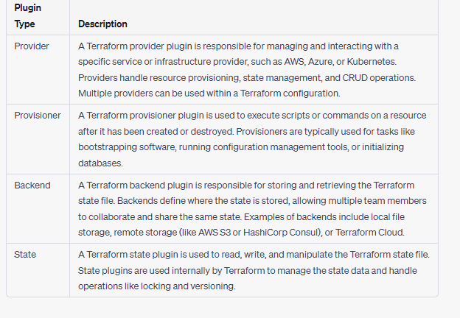
..

Slide 4
Provider Plugins
Purpose: Provider plugins enable Terraform to interact with different infrastructure platforms (e.g., AWS, Azure, GCP). Each provider plugin implements the necessary functionality to manage resources on a specific platform.
Example: Suppose you want to provision AWS EC2 instances using Terraform. To achieve this, you need the AWS provider plugin. You would configure the AWS provider in your Terraform files, and when you run terraform plan or terraform apply, Terraform uses the AWS provider plugin to communicate with the AWS API, create, modify, or delete EC2 instances.

Slide 5
Provisioner Plugins
Purpose: Provisioner plugins allow Terraform to execute additional actions on resources during the provisioning process. These actions can include running scripts, executing commands, or performing configuration tasks on the created resources.
Example: Let's say you want to install specific software on an EC2 instance after provisioning it with Terraform. You can use a provisioner plugin, such as the "remote-exec" provisioner, to execute shell commands on the EC2 instance once it's created. This plugin allows you to run scripts or commands remotely on the provisioned resource.

Slide 6
State Backend Plugins
Purpose: State backend plugins handle the storage and retrieval of Terraform state. They define where the state file is stored and how to access it. Different backend plugins support various storage options like local file system, remote storage systems (e.g., Amazon S3, Azure Blob Storage), or remote state management services (e.g., Terraform Cloud, HashiCorp Consul).
Example: If you want to store your Terraform state in an S3 bucket, you would use the S3 backend plugin. This plugin configures Terraform to store and retrieve the state file from the specified S3 bucket. When you run Terraform commands, the S3 backend plugin handles the interaction with the S3 API.

Slide 7
External Data Source Plugins
Purpose: External data source plugins allow Terraform to fetch data from external sources and use it within the Terraform configuration. These plugins retrieve data from APIs, databases, or other external systems and provide the fetched data as input to Terraform resources.
Example: Imagine you need to fetch information about existing AWS security groups to be used within your Terraform configuration. You can use an external data source plugin, such as the AWS Security Group data source plugin. This plugin communicates with the AWS API, retrieves the desired security group details, and exposes them as data that can be used in your Terraform resources.

